Slide 1


Reducing credit default rate at ABC bank
Ppt presented by:
Aprajita chhawi

Slide 2
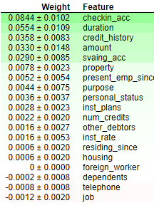
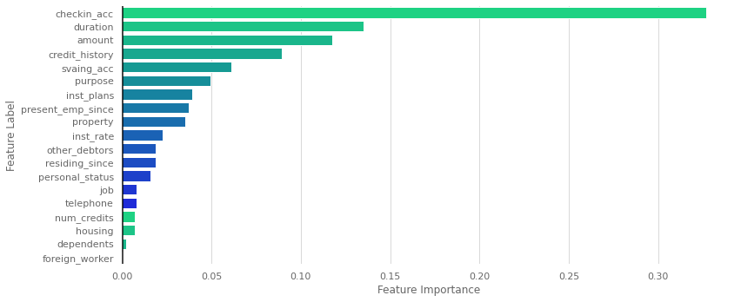
Feature Importance using eli5
Weight of each feature
Feature importance using plot

Slide 3
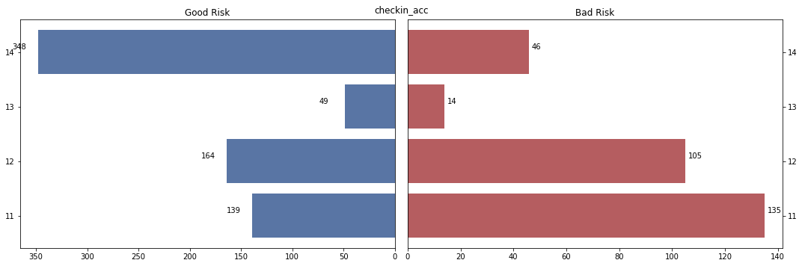
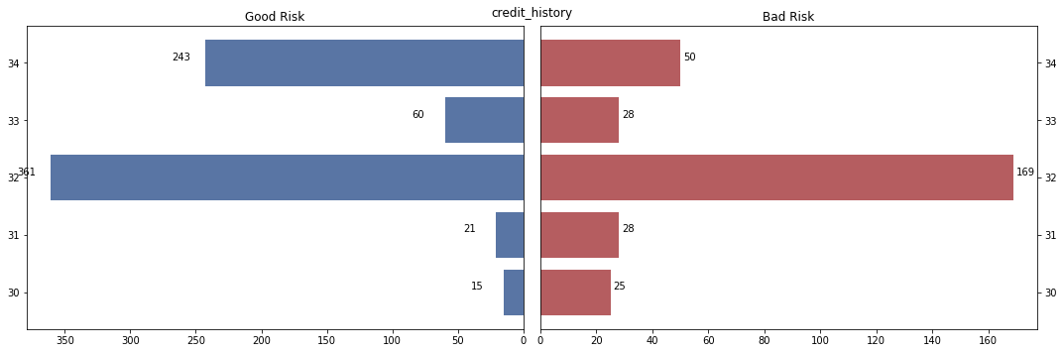
Comparing good risk vs bad risk in each feature
Checking account status
Credit history

Slide 4
Which approach did I consider for cost measures?
The case study needed that is appropriate for evaluating the predicted class label.
Considered precision and recall as primary evaluating factors
Studied in a report that for banks:
COST(False Negatives) > COST(False Positives)
I used beta version of F-measure that calculates a weighted harmonic mean of precision but favours higher recall scores over precision scores.

Slide 5
Which Model did I use?
LogisticRegression
Using a Dummy Classifier class from scikit-learn library and setting the strategy argument to constant and constant argument to 1 for minority class.
Then I used the basic models such as Logistic Regression, LDA Classifier, Guassian NB and SVM classifiers for analysis.
Then for the final model application, I used Power Transformer and MinMax Scalar for preprocessing, repeated edited nearest neighbour for under sampling, Logistic class weighted as base model.

Slide 6


All the ipynb files are attached in zip
THANK-YOU

